Slide 1
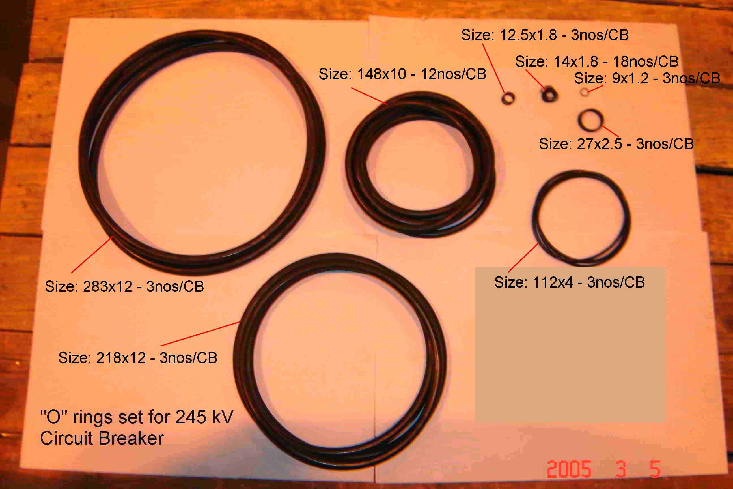
SIEMENS
HVCB SPARES
“O” rings set for complete 245KV,50KA CB
S4799246301

